Slide 1
Secret Data Sharing Through Image Adaptive Data For Security System Using Error Correction
Project Guide:
Ms.Baby.D.Dayana M.E, A.P(O.G)
Batch Number:
D10
Batch Mates:
V.S.P.P.K Prithvi (RA1411003020190)
Akhil Mantha (RA1411003020228)
M.Manideep (RA1411003020232)
Karan Khosla (RA1411003020222)
SRM INSTITUTE OF SCIENCE AND TECHNOLOGY-CSE
1/14

Slide 2
Abstract:
An enhancement of data protection system for secret communication using reserve room in encrypted images based on color co-ordination and gray scale variation. The Selective embedding is utilized in this method to determine host signal samples suitable for data hiding.
Gray Scale variation is prefered over a complete image so that there is no loss in bits while transmission. Gray scale is an object or an entity of an image. Here a complete image is consiederd rather than a gray scale entity as the image is sharp and descriptors can be used for the luminance channel Such as SURF(speeded up robust features) the applications operate only on luminance channels. The color image is converted to a gray image as the it reduces the computation cost.
SRM INSTITUTE OF SCIENCE AND TECHNOLOGY-CSE
2/14

Slide 3
Existing Methods:
Direct bit replacement Process
Reverse data hiding using RC7 algorithm
Drawbacks:
Embedding Robustness is less
Edge information loss due to ringing artifact.
Low hiding capacity & low security
SRM INSTITUTE OF SCIENCE AND TECHNOLOGY-CSE
3/14

Slide 4
Proposed Method:
The Image Steganography technique is based on,
To overcome noise in the media by proposing a difference expansion algorithm
Audio hiding process
Finding the difference between the significant pixel pair or the vectors which can also improve the efficiency and the compressibility of the location map.
SRM INSTITUTE OF SCIENCE AND TECHNOLOGY-CSE
5/14

Slide 5
Advantages:
High hiding Capacity & High Robustness
Less degradation in Image quality during hiding
SRM INSTITUTE OF SCIENCE AND TECHNOLOGY-CSE
6/14

Slide 6
Software Requirement:
MATLAB 9.3 and above versions.
Image and Video Processing toolboxes
Octave and python 3.6
SRM INSTITUTE OF SCIENCE AND TECHNOLOGY-CSE
7/14

Slide 7
1 Bin/2 Bin MPE2 Algorithm
This is a RDH algorithm that is based on the idea of employing two predictors to compute the predictions in order to take advantage of the different capabilities of different predictors.
This is expected to increase the prediction accuracy, hence, increasing the embedding capacity.
Additionally, and unlike the MPE algorithm, the proposed algorithm uses one bin of the prediction errors histogram for embedding the data.
SRM INSTITUTE OF SCIENCE AND TECHNOLOGY-CSE
8/14

Slide 8
Pixels & Color Coherence Vectors (ccv) Pseudo Steps
Blur the image slightly by replacing the pixel values.
Eliminates small variations between neighboring pixels.
Discretize the color-space such that only n distinct colors.
Classify the pixels in the given color bucket.
Check the given value τ which is a constant. If the pixel value is less than tau then the given pixel is incoherent.

Slide 9
Block Diagram: Embedding Process:
Embedding Process:
Input Image
Pixel/Vector difference & Select Channel
Pixels/Vectors
Secret Data
RC7
Encryption
Data Embedding
Stego Image
Audio Input
Image Embedding
1 Bin MPE2
Algorithm
Audio output
SRM INSTITUTE OF SCIENCE AND TECHNOLOGY-CSE
9/14

Slide 10
Extraction Process:
Audio output
Stego Image Extraction
Plane Separation & Select Channel
Extraction process
Recover Image
RC7 Decryption
Audio Extraction
1 Bin MPE2 Extracction Process
Original Data
SRM INSTITUTE OF SCIENCE AND TECHNOLOGY-CSE
10/14

Slide 11
Methodologies:
Plane Separation/ Pixel/ Vector Difference
RC7 Encryption
LSB Embedding and Extraction
Audio Input signal
1 Bin MPE2 Encryption/Decryption
Performance analysis
SRM INSTITUTE OF SCIENCE AND TECHNOLOGY-CSE
11/14

Slide 12
Conclusion
Using a complete image instead of gray scale variation
Using RC7 Algorithm with an error control method
Done research on 1 Bin MPE2 algorithm which can be used to detect the error while finding the difference between pixel frames or vector difference.
SRM INSTITUTE OF SCIENCE AND TECHNOLOGY-CSE
13/14

Slide 13
References
[1] J. Fridrich and M. Goljan, “Lossless data embedding for all image formats,” in Proc. SPIE Proc. Photonics West, Electronic Imaging, Security and Watermarking of Multimedia Contents, San Jose, CA, USA, Jan. 2002, vol. 4675, pp. 572–583.
[2] V. Sachnev, H. J. Kim, J. Nam, S. Suresh, and Y.-Q. Shi, “Reversible watermarking algorithm using sorting and prediction,” IEEE Trans. Circuits Syst. Video Technol., vol. 19, no. 7, pp. 989–999, Jul. 2009.
[3] F. M. Willems and T. Kalker. “Coding theorems for reversible embedding.” DIMACS Series in Discrete Mathematics and Theoretical Computer Science, vol. 66, pp.61-78, 2004.
[4] J. Tian, “Reversible data embedding using a difference expansion,” IEEE Trans. Circuits Syst. Video Technol., vol. 13, no. 8, pp. 890–896, Aug. 2003.
[5] Z. Ni, Y. Shi, N. Ansari, et al., “Reversible data hiding,” IEEE Trans. Circuits Syst. Video Technol., vol. 16, no. 3, pp. 354–362, Mar. 2006.
SRM INSTITUTE OF SCIENCE AND TECHNOLOGY-CSE
14/14

Slide 14
RGB Images
An RGB image, sometimes referred to as a "truecolor" image, is stored in MATLAB as an m-by-n-by-3 data array that defines red, green, and blue color components for each individual pixel.
RGB images do not use a palette.The color of each pixel is determined by the combination of the red, green, and blue intensities stored in each color plane at the pixel's location.
Graphics file formats store RGB images as 24-bit images, where the red, green, and blue components are 8 bits each.
This yields a potential of 16 million colors. The precision with which a real-life image can be replicated has led to the commonly used term "truecolor image."

Slide 15
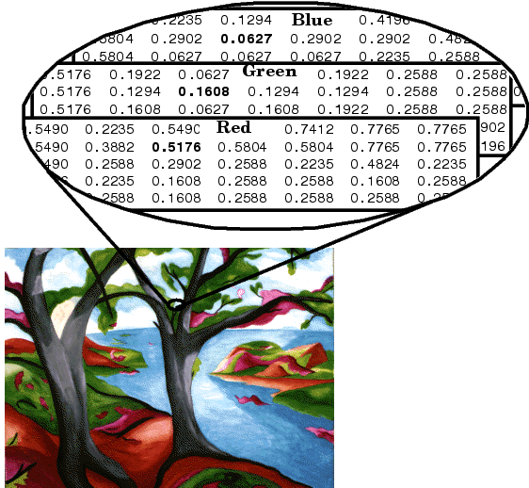
RGB Images

Slide 16
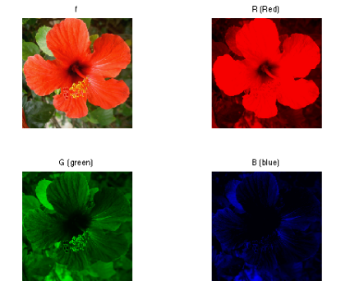
Plane separation
To further illustrate the concept of the three separate color planes used in an RGB image, the code sample below creates a simple RGB image containing uninterrupted areas of red, green, and blue, and then creates one image for each of its separate color planes (red, green, and blue).

Slide 17
Application:
Research institute.
Medical information protection.
Defense application.

Slide 18
RC7 Encryption Algorithm
To improve the encryption efficiency of the already existing RC6 algorithm [20], RC7 has been proposed which takes relatively less time to encrypt data and is comparatively more flexible.
Instead of four working registers, RC7 makes use of six such registers which makes it a better alternative to RC6.

Slide 19
Data Embedding
Data hiding is a process to conceal secret message bits into another medium like image, audio or video files.
Here, the hiding is performed under compressed bit stream of cover image. After obtaining of bit streams, it is allowed to encrypt with random binary string using bitxor operation.
Before data hiding, the text message will be encrypted using chaos encryption to make second level security during transmission.
Bits wrap method is used here to conceal secret text bits under encrypted compressed bit streams. It is performed using logical bitwise operations like ‘bitand’ and ‘bitor’ operations.
After hidden the data, image reconstruction and data extraction will be performed to measure the system performance.

Slide 20
Data Encryption Flow
Initiate Constant factors
Input text
Chaotic Sequence Generation
Xn+1 = u*x(1-x)
Threshold function
(I/255)< Xn+1 < (I+1)/255
Bit XOR
E_{i} = M_{i} (bitxor) I
Encrypted Text

Slide 21
Process Flow
Secret Text
Encrypted Bit stream
if M_{bit} == C_{bit}
Binary String Conversion
C_{bit} is unchanged
if M_{bit} > C_{bit}
Out = C_{bit} (bitor) M_{bit}
Is it last bit
if M_{bit} < C_{bit}
Out = C_{bit} (bitand) M_{bit}
C_{bit} - Compressed Bits M_{bit} - Message Bits
End

Slide 22
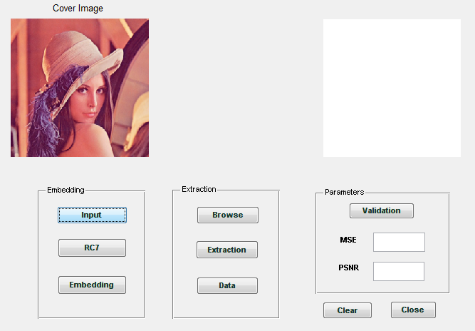
Input Image Selection

Slide 23
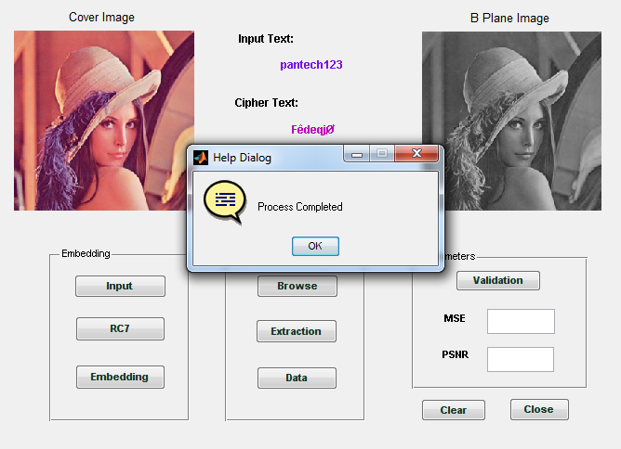
RC7 Encryption

Slide 24
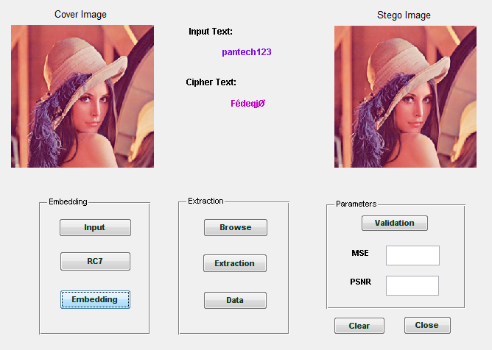
Embedding Process

Slide 25
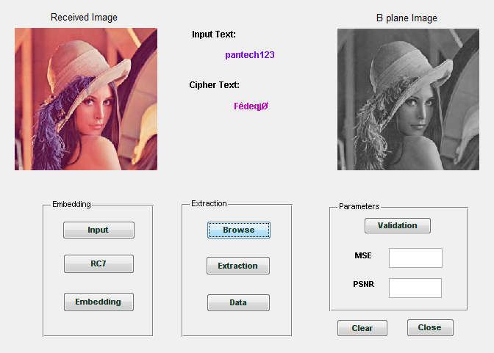
Stego Image selection

Slide 26
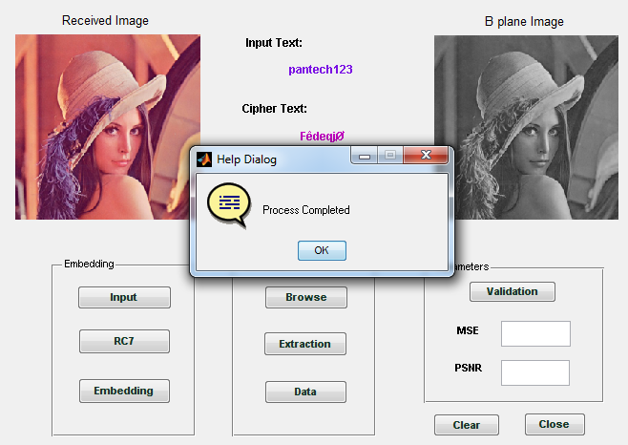
Extracted Image

Slide 27
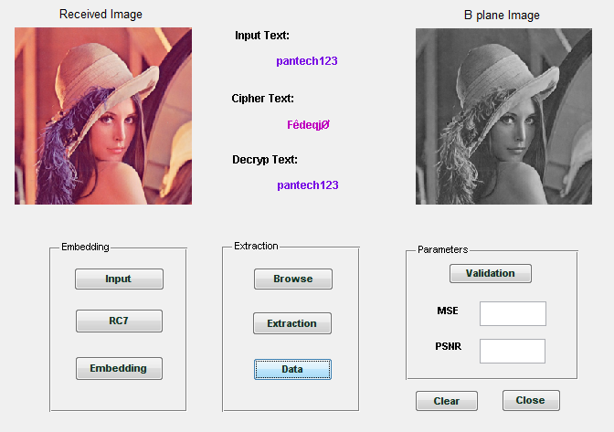
Extracted Data

Slide 28
Continues..
[6]. Expansion Embedding Techniques for Reversible Watermarking Diljith M. Thodi and Jeffrey J. Rodríguez, Senior Member, IEEE
[7]. An Improved Reversible Data Hiding in Encrypted Images Using Side Match Wien Hong, Tung-Shou Chen, and Han-Yan Wu
[8]. On Compressing Encrypted DataMark Johnson, Student Member, IEEE, Prakash Ishwar, Vinod Prabhakaran, Student Member, IEEE,Daniel Schonberg, Student Member, IEEE, and Kannan Ramchandran, Senior Member, IEEE
[9]. Reversible Data HidingZhicheng Ni, Yun-Qing Shi, Nirwan Ansari, and Wei Su
[10]. Improving Various Reversible Data Hiding Schemes Via Optimal Codes for Binary Covers Weiming Zhang, Biao Chen, and Nenghai Yu

